Slide 1
Command Query Responsibility Segregation
By: Katherine Baillie, Rachel Wang, Justine Chen, and Shovon Saha

Slide 2
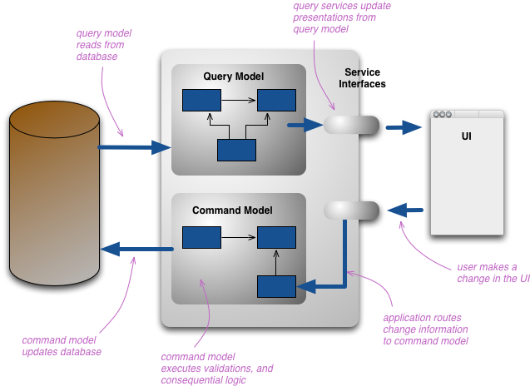
CQRS: Command Query Responsibility Segregation
Photo source: https://martinfowler.com/bliki/CQRS.html

Slide 3
Commands vs. Queries
Commands
Queries
Writing to the database
Making edits to information in the database
Deleting records from the database
Reading data from database

Slide 4
CQRS vs. CRUD
CQRS
CRUD
"Command Query Responsibility Segregation"
Command and Query functionality is separated into separate services
Command or Query services can be scaled individually
"Create Read Update Delete"
Command and Query services are combined into a single service
All functionality can only be scaled as a unit

Slide 5
When is CQRS Beneficial?
High performance application
When the loads from "read" and "write" events are significantly different
Event-based programming models, so temporary failure of one microservice won't affect the other
When there is a large scale application that evolves over time, and different teams are working on "read" and "write" models.
When "write" is much more complicated to implement than "read".

Slide 6
When is CQRS unnecessary?
On simple CRUD domains, where additional complexity is not required: a simple application that uses one JPA.
The domain and business rules are simpler.
Since it is a complicated structure, if there's not enough time and resource, CQRS might be troublesome to implement.

Slide 7
CQRS on a Liberty Application

Slide 8
Music Charts Application
Command (Write)
Create a new song
Delete a song
Update a song
Add a "Like"
Change the name, artist or price
Query (Read)
Find a song
Find all songs
View Top 10 songs

Slide 9
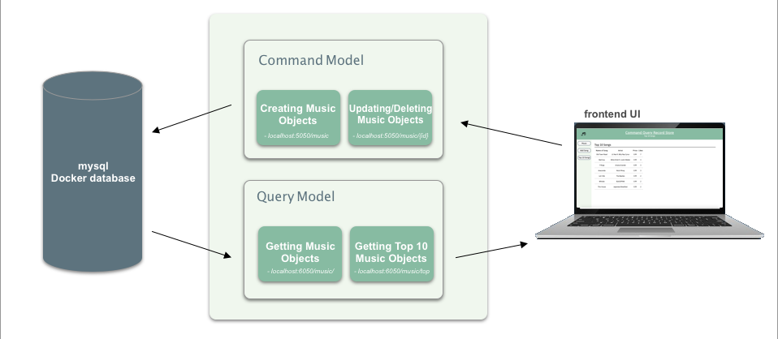
CQRS Music Charts Application on Liberty

Slide 10
Demo

Slide 11
What is next?
Implement "our own" JPA, so instead of using two JPA, we write our own code to have write update the database, and read that fetches information from database.
Add event-resourcing using Reactive to this application to avoid update conflicts.
Create "rate the music" function
Have two roles: "admin" can add, update, and delete music. Normal users can only view (query) and like the music

Slide 12
Thank you
Questions?

